Slide 1
Multiplexing

Slide 2




Note
Bandwidth utilization is the wise use of available bandwidth to achieve specific goals.
Efficiency can be achieved by multiplexing; i.e., sharing of the bandwidth between multiple users.

Slide 3














































MULTIPLEXING
Whenever the bandwidth of a medium linking two devices is greater than the bandwidth needs of the devices, the link can be shared. Multiplexing is the set of techniques that allows the (simultaneous) transmission of multiple signals across a single data link. As data and telecommunications use increases, so does traffic.

Slide 4
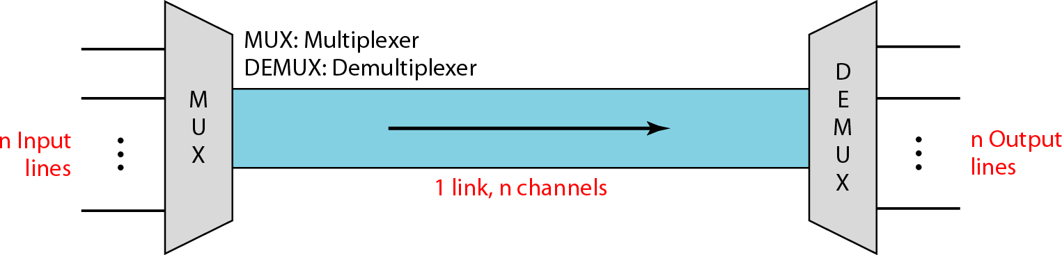
Dividing a link into channels

Slide 5
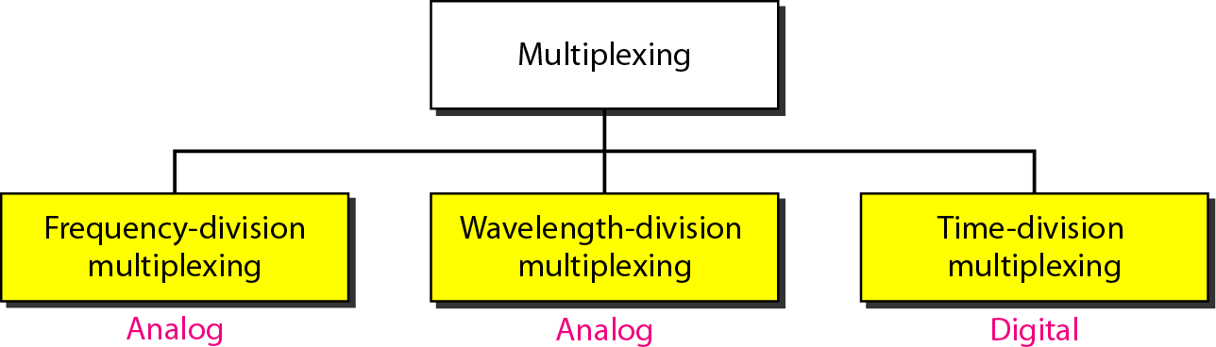
Categories of multiplexing

Slide 6
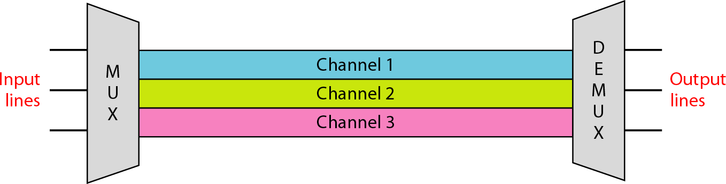
Frequency-division multiplexing (FDM)

Slide 7
Note
FDM is an analog multiplexing technique that combines analog signals.
It uses the concept of modulation

Slide 8
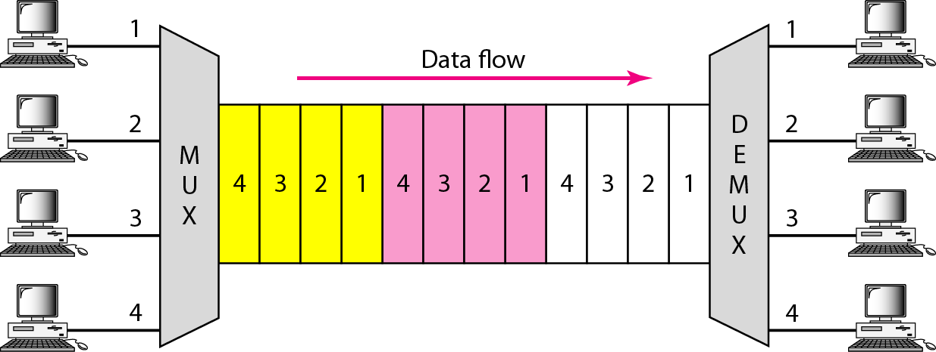
Time Division Multiplexing (TDM)

Slide 9
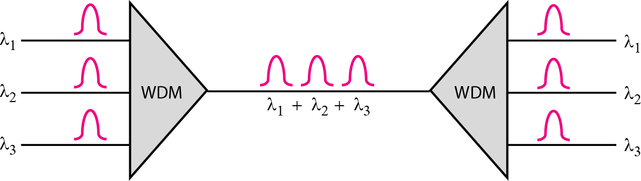
Wavelength-division multiplexing (WDM)
6.9

Slide 10
Note
WDM is an analog multiplexing technique to combine optical signals.
6.10

Slide 11
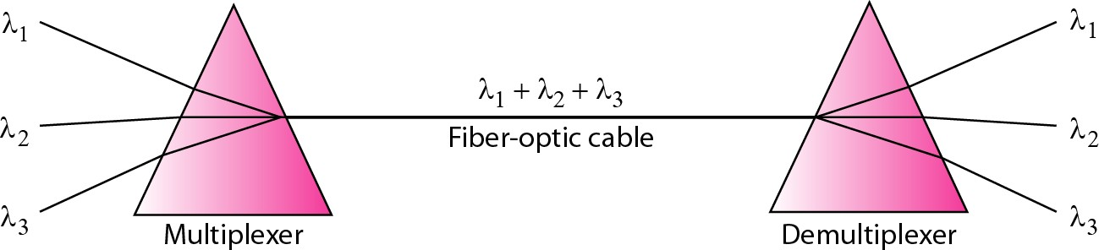
Prisms in wavelength-division multiplexing and demultiplexing
6.11

